Slide 1
Local Search (1)
Shaowei Cai, UCAS, 2020

Slide 2
The Local Search Books
Stochastic Local Search: Foundations and Applications, 2004
Local search in combinatorial optimization (Emile Aarts,1997)
Theoretical Aspects of Local Search
(Wil Michiels · Emile Aarts · Jan Korst, 2007)

Slide 3
What is Heuristic?
"The word comes from Archimedes' famous exclamation when in the bath it suddenly struck him how he could decide whether King Hieron's crown was made of real gold or not. Screaming "heureka" (I got it, I found it), Archimedes ran naked along the main street of Syracuse to make the test as soon as possible."

Slide 4
What is Heuristic?
"The name heuristics applies to every rule, conclusion, evaluation, and principle that works in certain situations most of the time, but not always."
“Artificial Intelligence also needs heuristics, because thinking over all the branches of the chains of reasoning is mostly impossible even by the fastest computers."
---from "Ways of Thinking: The Limits of Rational Thought and Artificial Intelligence"

Slide 5
What is Heuristic?
“In fact, if the algorithm is complicated enough, proving things about it (i.e., whether or not it works) becomes very difficult for even the best experts.
Thus not all algorithms that have been designed have been analyzed.
The algorithms we study today are called heuristics: for most of them we know that they do not work on worst-case instances, but there is good evidence that they work very well on many instances of practical interest. Explaining this discrepancy theoretically is an interesting and challenging open problem.”
--- Sanjeev Arora

Slide 6
What is Heuristic?
Why use heuristics:
We don’t have other good choices.
In practice, they can have good performance
SAT Solvers, ILP Solvers…
A popular heuristic method is local search.
starts from a candidate solution and then iteratively modifies it.

Slide 7
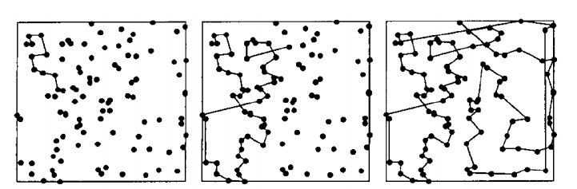
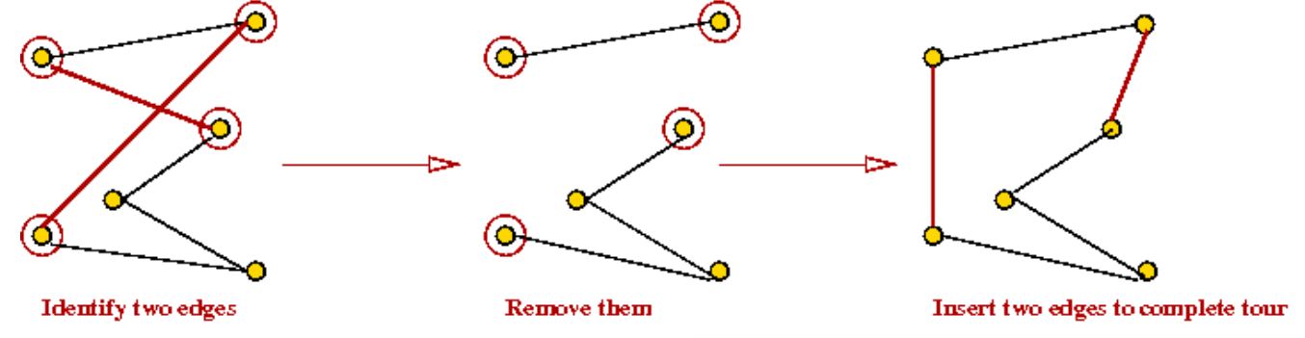
Types of Heuristic Methods
Construction ←→ Local Search

Slide 8
Types of Heuristic Methods
Types of search methods:
systematic search ←→ local search

Slide 9
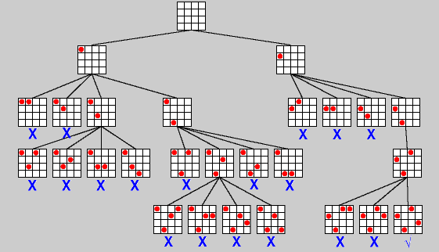
Example: Backtracking for 4-Queen

Slide 10
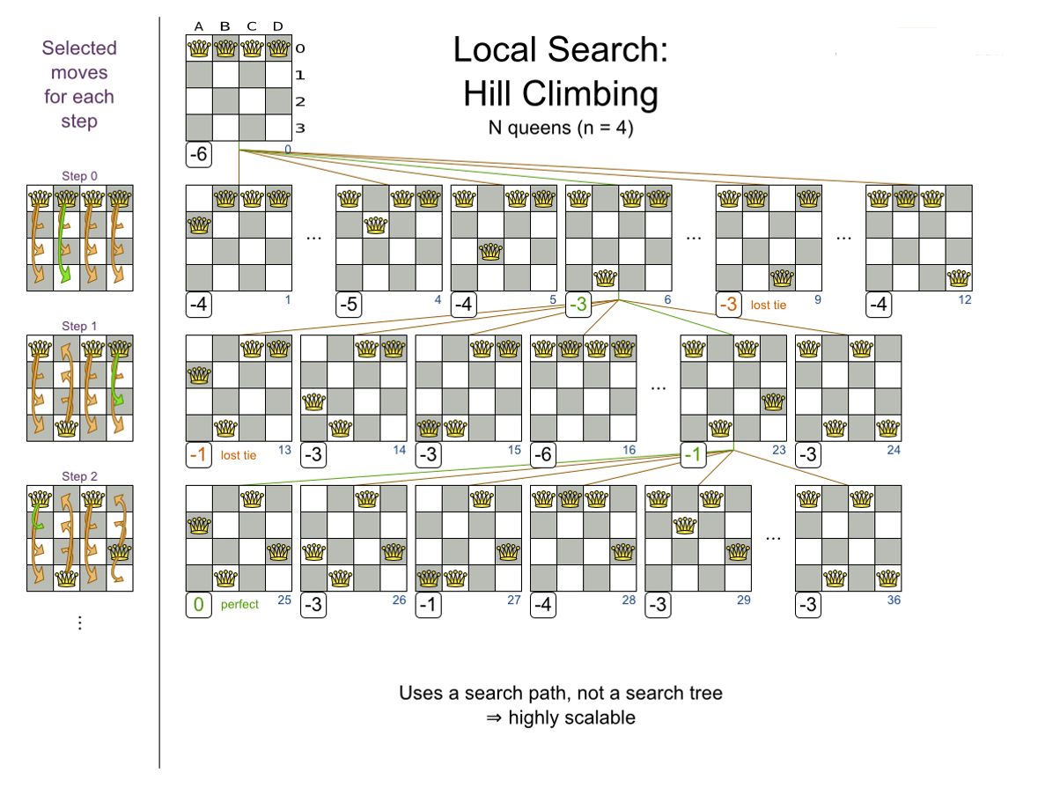
Example: Local search for 4-Queen

Slide 11
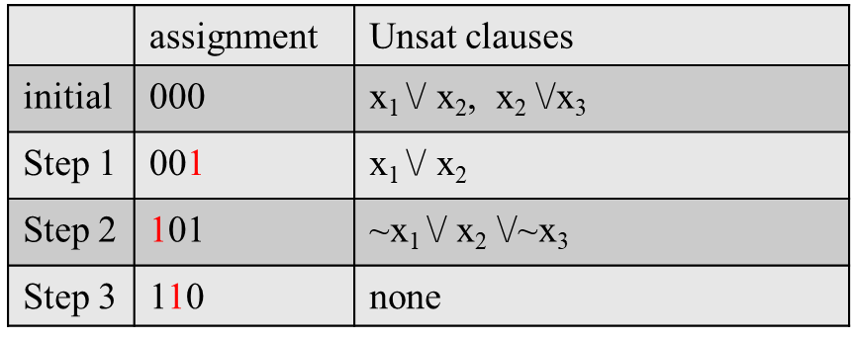

Example: A local search procedure for MaxSAT
F={$x_{1}∨¬x_{2}, x_{1}∨x_{2}, x_{2}∨x_{3},¬x_{1}∨x_{2}∨¬x_{3}$}

Slide 12
Local Search (LS) Algorithms
search space S
(SAT: set of all complete truth assignments to variables)
solution set S′ ⊆ S
(SAT: models of given formula)
neighbourhood relation N ⊆ S × S
(SAT: neighbouring variable assignments differ in the truth value of exactly one variable)
objective function f : S → R+
(SAT: number of clauses unsatisfied under given assignment)
evaluation function g : S → R⁺
(g1=number of clauses unsatisfied under given assignment;
g2=total weight of clauses unsatisfied under given assignment, using clause weighting techniques.)

Slide 13
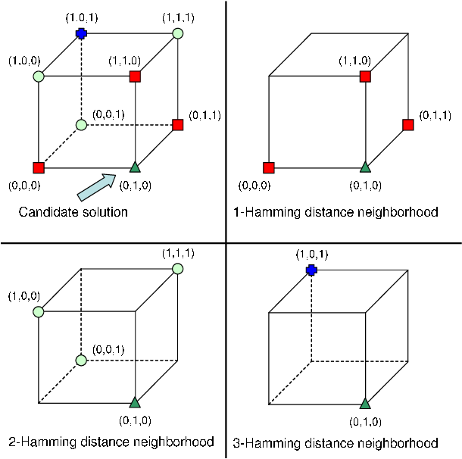
Hamming distance neighborhood relations

Slide 14
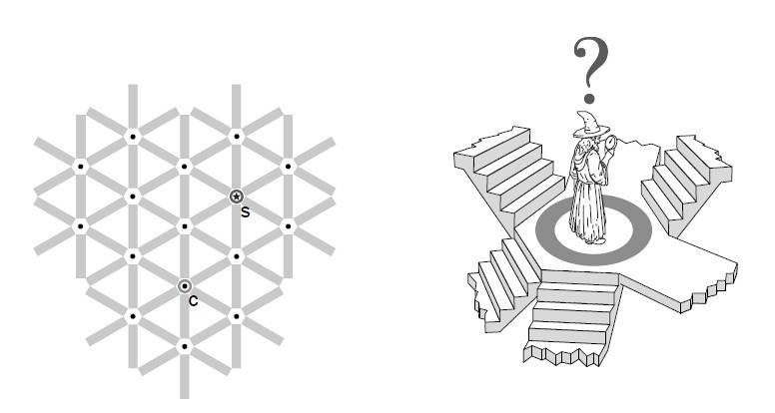
A geometrical viewpoint of Local Search
the whole search space forms a network
a local search algorithm starts from an initial position
iteratively moves from current position to neighbouring position
use evaluation function for guidance
important components in local search design
Neighbourhood relation (or, move/operator)
Evaluation function

Slide 15
Pros. and Cons. of Local Search
Pros:
simple and esay to implement
use limited memory
able to find reasonable solutions in large search space
easy to parallelize
Cons:
often incomplete
often difficult to analyze theoretically

Slide 16
When to use Local Search
When to use Local Search
Know little about the problem
Approximate solutions are acceptable
Time resource is limited or very valuable
The instance is very large

Slide 17
Representation in local search
Local search algorithm design usually starts from representations.
How to represent a candidate solution for these problems?
Assignment problems (SAT)
Subset problems (vertex cover, clique)
Permutation problems (TSP)

Slide 18
Neighborhood/Operators in local search
We need to define the neighborhood relation.
-- Usually, we define the operators instead.
-- the neighborhood of a candidate solution is those can be visited by the operations in one local search step.
What operators will you design for these problems?
Assignment problems (SAT)
Subset problems (vertex cover, clique)
Permutation problems (TSP)
Operator and Operation

Slide 19
A Simple Local Search
Iterative Improvement (Greedy Search):
initialize search at some point of search space
in each step, move from the current search position to a neighbouring position with a better evaluation function value

Slide 20
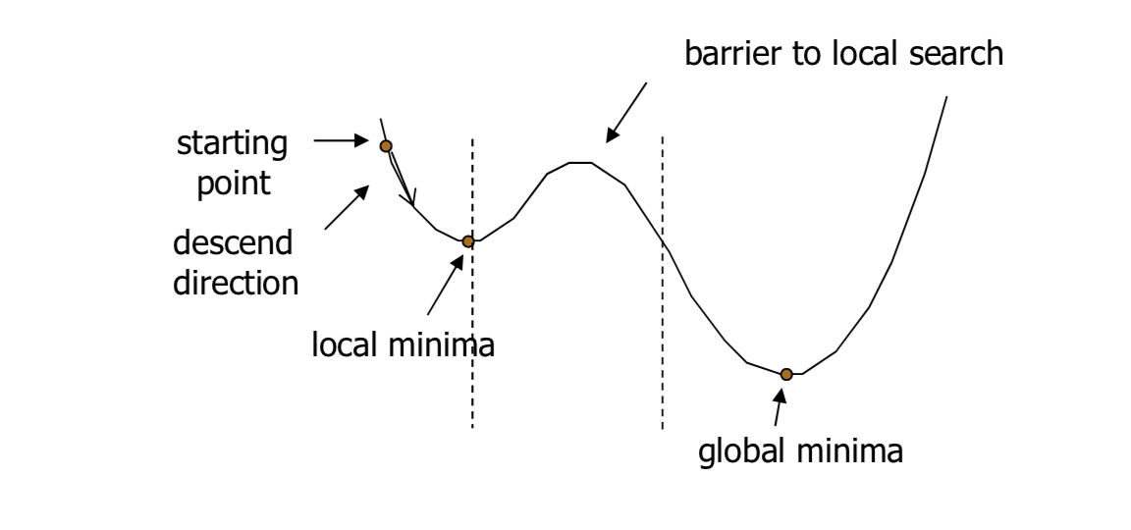
Typical problems with local search
Cycling
stuck in local optima

Slide 21
Local optima w.r.t. neighborhood relation
Local minima depend on the evaluation function and neighbourhood relation N.
Larger neighbourhoods N(s)
neighbhourhood graphs with smaller diameter, i.e. max_{u,v}d(u,v);
fewer local minima.
more costly to be search.
Exteme case: exact neighbourhood
for which any local optimum is also guaranteed to be a global optimum.
exact neighbourhoods are too large to be searched effectively (exponential in size of problem instance).

Slide 22
Stochastic Local Search:
randomize initialization step
random initial solutions
randomized construction heuristics
randomize search steps
such that suboptimal/worsening steps are allowed
improved performance & robustness
typically, degree of randomization controlled by probability parameter

Slide 23
Simple SLS methods
Random Search (Blind Guessing):
In each step, randomly select one element of the search space.
(Uninformed) Random Walk:
In each step, randomly select one of the neighbouring positions of the search space and move there.

Slide 24
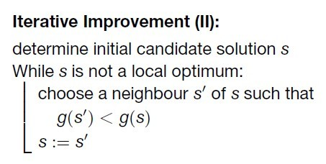

Slide 25
run a small example
Neighbourhood relation: hamming distance 1
Evaluation function: the number of unsat clauses
S=<000>, N(S)={S1,S2,S3}={<100>,<010>,<001>}
g(S)=2
g(S1) =1
g(S2) =1
g(S3) = 2
In iterated improvement, the algorithm moves from S to which assignment?
F={x₁ \/ ~x₂, x₁ \/ x₂, x₂, ~x₁ \/ x₂ \/~x₃}
 | assignment | unsatisfied clauses
S | 000 | x₁ \/ x_{2,} x₂

Slide 26
Score of Variables
Usually, we do not calculate the evaluation function for the neighboring candidate solutions.
Instead, we calculate the score for each variable.
---We have efficient method for calculating scores.
For a variable x, score(x) = g(S)-g(S'), where S' differs from S only in the value of x.
score(x₁)=g(000) - g(100)=2-1=1
score(x₂)=g(000) - g(010) = 2-1=1
score(x₃)=g(000) - g(001) = 2-2=0
F={x₁ \/ ~x₂, x₁ \/ x₂, x₂, ~x₁ \/ x₂ \/~x₃}
 | assignment | unsatisfied clauses
S | 000 | x₁ \/ x_{2,} x₂

Slide 27
Score of Variables
Usually, we do not calculate the evaluation function for the neighboring candidate solutions.
Instead, we calculate the score for each variable.
---We have efficient method for calculating scores.
For a variable x, score(x) = g(S)-g(S'), where S' differs from S only in the value of x.
score(x₁)=g(100) - g(000)=1-2=-1
score(x₂)=g(100) - g(110) =1-0=1
score(x₃)=g(100) - g(101) =1-2=-1
F={x₁ \/ ~x₂, x₁ \/ x₂, x₂, ~x₁ \/ x₂ \/~x₃}
 | assignment | unsatisfied clauses
S | 000 | x₁ \/ x_{2,} x₂
S | 100 | x₂

Slide 28
Score of Variables
F={x₁ \/ ~x₂, x₁ \/ x₂, x₂, ~x₁ \/ x₂ \/~x₃}
 | assignment | unsatisfied clauses
S | 000 | x₁ \/ x_{2,} x₂
S | 100 | x₂
S | 110 | _{None}

Slide 29
Iterative Improvement for MaxSAT
S := a random complete assignment;
while (1)
if (exist variables with positive score)
x := a variable with positive score;
S := S with x flipped;
else
return S;

Slide 30
Iterative Improvement for MaxSAT
S := a random complete assignment;
while (1)
if (exist variables with positive score)
x := a random variable with positive score;
S := S with x flipped;
else
return S;

Slide 31
Iterative Improvement for MaxSAT
S := a random complete assignment;
while (1)
if (exist variables with positive score)
x := a variable with the best positive score;
S := S with x flipped;
else
return S;

Slide 32
Invariant of Iterative Improvement for SAT
GSAT [Selman et al, AAAI 1992]
S := a random complete assignment;
while (!termination condition)
if (S is a solution) return S;
x := a variable with the best score;
S := S with x flipped;
return S;

Slide 33
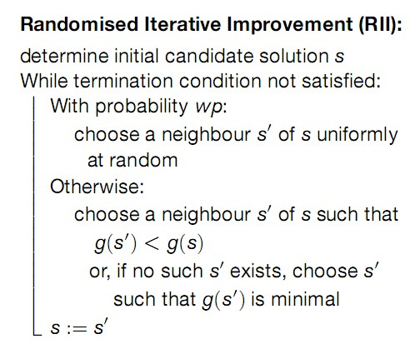

Slide 34
GWSAT [Bart Selman and Henry Kautz, 1993]
search steps:
– with probability p, choose a variable appearing in an unsatisfied clause randomly
– otherwise, select a variable with the best score

Slide 35
General SLS Framework
procedure SLS-Decision(π)
input: problem instance π ∈ Π
output: solution s ∈ S(π) or ∅
(s) := init(π);
while not terminate(π, s) do
s := step(π, s);
if s ∈ S(π) then
return s
else
return ∅
procedure SLS-Minimization(π)
input: problem instance π ∈ Π
output: solution s ∈ S(π) or ∅
(s) := init(π);
s* := s;
while not terminate(π, s) do
s := step(π, s);
if f(π, s) < f(π, s*)
s* := s;
if s* ∈ S(π) then
return s*
else
return ∅

Slide 36
Simple SLS Methods
Simple SLS Methods
Random Walk(RW) (recall)
Iterative Improvement(II)
Randomized Iterative Improvement(RII) (recall)
Variable Neighbourhood Descent (VND)
Simulated Annealing(SA)

Slide 37
Trade-off in Local Search
An example trade-off:
Using larger neighbourhoods can improve performance of II(and other SLS methods).
But: time required for determining improving search steps increases with neighbhourhood size.
More general trade-off:
Effectiveness vs time complexity of search steps.

Slide 38
Variable Neighbourhood Descent
Recall: Local minima are relative to neighbourhood relation.
Key idea: escape from local minimum of given neighbourhood relation, by switching to different neighbhourhood relation.
Use k neighbourhood relations N₁, . . . ,N_{k} , (typically) ordered according to increasing neighbourhood size.
Always use smallest neighbourhood that facilitates improving steps.

Slide 39
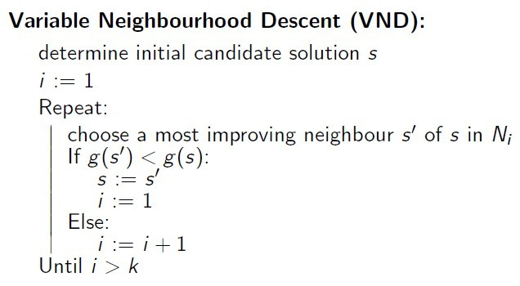

Slide 40
Think about it? How to design a VND for MaxSAT
How to define neighbourhood relations N₁, . . . ,N_{k} ?
When to switch to a larger neighborhood?
When to switch to smaller neighborhood?

Slide 41
Note:
VND often performs better than simple iterative improvement with large neighbourhoods
Many variants exist that switch between neighbhourhoods in different ways.
More general framework for SLS algorithms that switch between multiple neighbourhoods: Variable Neighbourhood Search (VNS) [Mladenovi´c and Hansen, 1997].

Slide 42
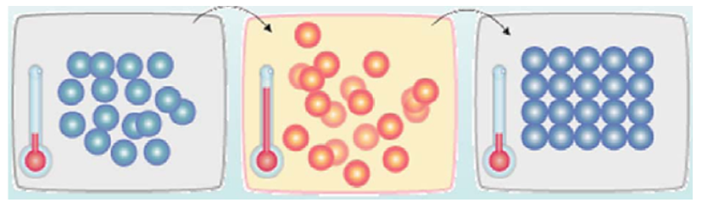
Simulated Annealing
local search technique inspired by the physical
process of annealing [Kirkpatrick et al. 1983, Cerny 1985]
Outline
generate a neighbour solution
probabilistically accept the solution
probability of acceptance depends on the objective function (energy function) difference and an additional parameter called temperature

Slide 43
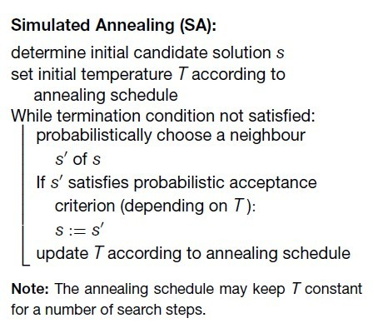

Slide 44
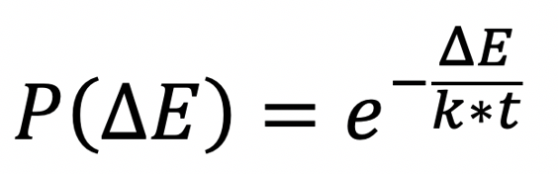
Solution generation
typically returns a random neighboring solution
Acceptance criterion
Metropolis acceptance criterion
better solutions are always accepted
worse solutions are accepted with probability
Annealing
parameter T, called temperature, is slowly decreased

Slide 45
High vs. Low Temperature
Higher temperature
more likely that the algorithm accepts a worse solution.
This promotes Exploration of the search space.
Lower temperature
the algorithm is less likely or will not to accept a worse solution.
This promotes Exploitation which means that once the algorithm is in the right search space, there is no need to search other sections of the search space and should instead try to converge and find the global maximum.

Slide 46
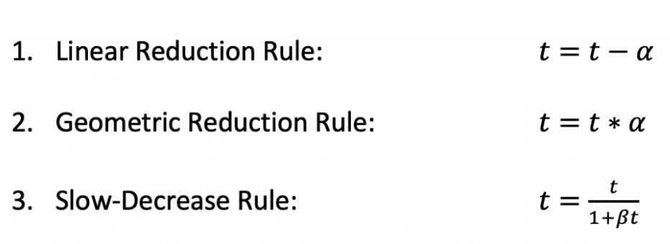
Generic choices for annealing schedule
initial temperature T₀
(example: based on statistics of evaluation function)
cooling schedule— how to change temperature over time
number of iterations at each temperature
(example: linear to the neighbourhood size)
stopping criterion
(example: no improved solution found for a number of temperature values; time limit.)

Slide 47
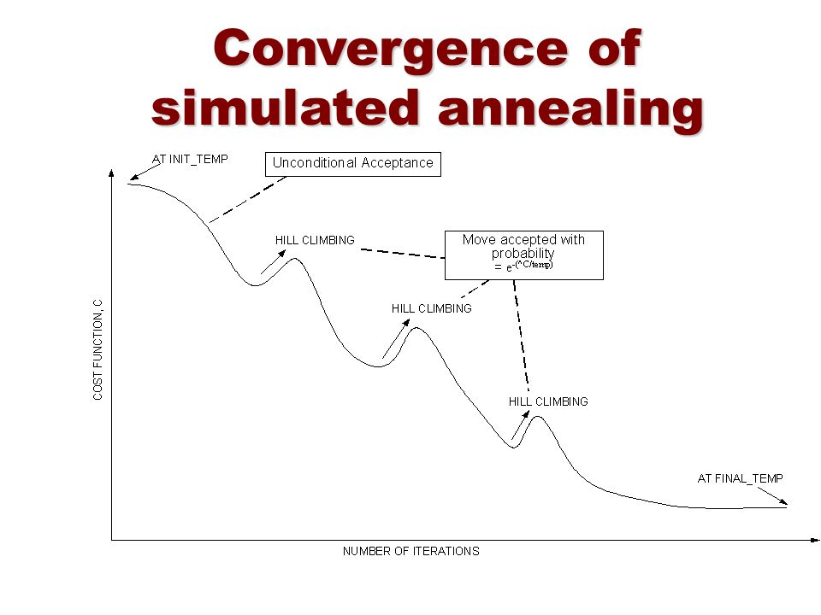

Slide 48
Hybrid SLS Methods
Hybrid SLS Methods
Iterated Local Search
Greedy Randomized Adaptive Search

Slide 49
Note: Many of the best-performing SLS algorithms
are combinations of various simple local search
strategies.
Simple examples:
Commonly used restart mechanisms can be seen as hybridizations with Uninformed Random Picking
Iterative Improvement + Uninformed Random Walk = Randomized Iterative Improvement
conceptual separation of simple search
strategies and (higher-level) search control

Slide 50
Iterated Local Search
Key Idea: Use two types of search steps:
subsidiary local search steps for reaching local optima as efficiently as possible (intensification, exploitation)
perturbation steps for effectively escaping from local optima (diversification, exploration).

Slide 51
Iterated Local Search for SAT
S := a random complete assignment;
while (!termination condition)
if (exsit variables with positive score)
x:= a variable with positive score;
S := S with x flipped.
else
make changes on S randomly.

Slide 52
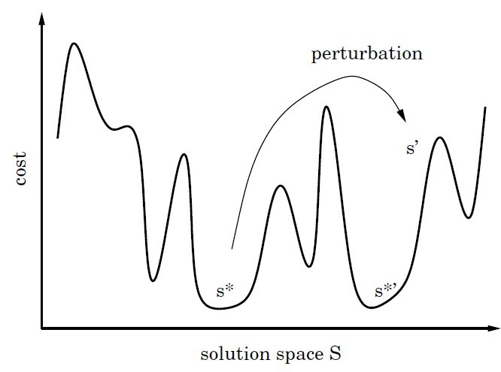
Subsidiary local search results in a local minimum.
ILS trajectories can be seen as walks in the space of
local minima of the given evaluation function.
Pictorial representation of iterated local search.

Slide 53
Trade-off in Local Search
Another trade-off:
trade off between intensification (exploitation) and diversification (exploration).
what if the search is too intensified?
what if the search is too diversified?

Slide 54
Trade-off in Local Search
Another trade-off:
trade off between intensification (exploitation) and diversification (exploration).
what if the search is too intensified?
easily get trapped in local optimum
what if the search is too diversified?
too much guess, could not get to good local optimum
This is an important trade-off in local search

Slide 55
Greedy Randomized Adaptive Search (GRASP)
Key Ideas:
Greedy construction finds high-quality solutions, and then apply local search.
Unfortunately, greedy construction only generates a very limited number of different candidate solutions (as the greedy strategy is fixed to some extent).
→ GRASP try to avoid this disadvantage by randomizing the construction method

Slide 56
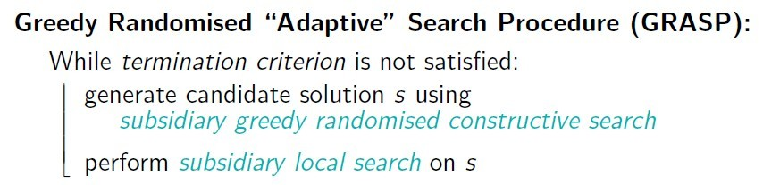

Slide 57
Restricted candidate lists (RCLs)
Each step of constructive search adds a solution component selected uniformly at random from a restricted candidate list(RCL).
RCLs are constructed in each step using a heuristic function h.
RCLs based on cardinality restriction comprise the k best-ranked solution components. (k is a parameter of the algorithm.)

Slide 58
GRASP for SAT
Subsidiary construction:
start from empty variable assignment
in each step, assign a currently unassigned variable
heuristic function h(i , v) := number of clauses that become satisfied by assigning x_{i} := v
RCLs based on cardinality restriction (contain fixed number k of atomic assignments with largest heuristic values)
Subsidiary local search:
iterative best improvement using 1-flip neighbourhood
terminates when model has been found or given number of steps has been exceeded

Slide 59
Population based SLS Methods
SLS methods discussed so far manipulate one candidate solution of given problem instance in each search step.
Straightforward extension: Use population (i.e., set) of candidate solutions instead.

Slide 60
Population-based SLS Methods
Evolutionary Algorithms
Ant Colony Optimization

Slide 61
Evolutionary Algorithms
Key idea: Iteratively apply genetic operators mutation, recombination, selection to a population of candidate solutions.
Inspired by simple model of biological evolution:
Mutation introduces random variation in the genetic material of individuals.
Recombination of genetic material during sexual reproduction produces offspring that combines features inherited from both parents.
Differences in evolutionary fitness lead selection of genetic traits (‘survival of the fittest’).

Slide 62
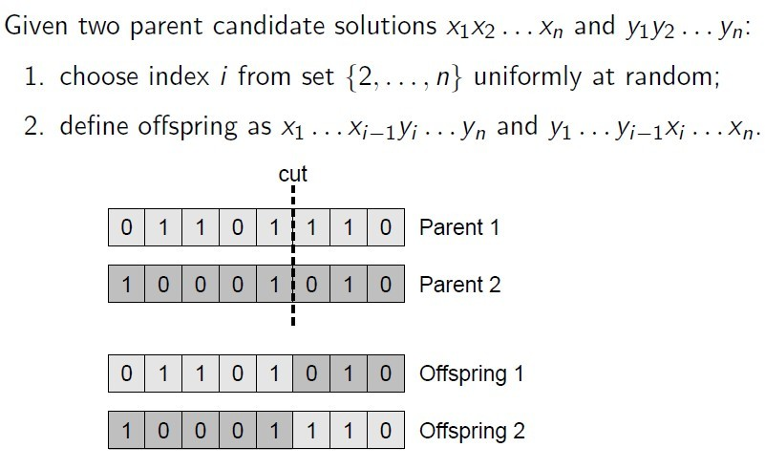
Recombination

Slide 63
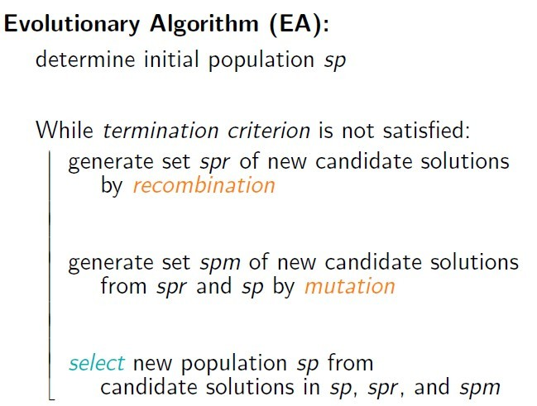

Slide 64
Problem: Pure evolutionary algorithms often lack capability of sufficient search intensification.
Solution: Apply subsidiary local search after initialization, mutation and recombination.
=> Memetic Algorithms

Slide 65
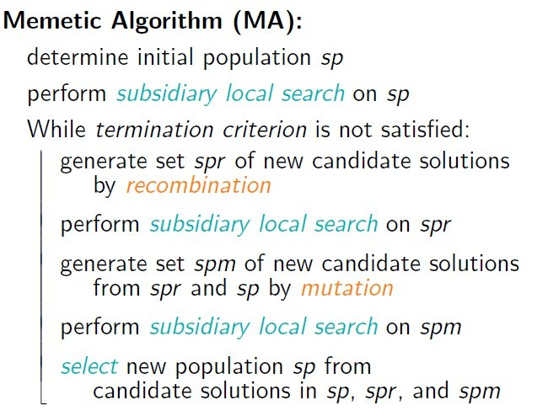

Slide 66
A memetic algorithm for SAT
Represent: truth assignments can be naturally represented as bit strings.
Use 1-flip neighbourhood relation;
Evaluation function: number of unsatisfied clauses.
Use population of k truth assignments;
initialize by (independent) Uninformed Random Picking.

Slide 67
Recombination: Generate offspring by binary crossovers on pairs of randomly selected assignments; offsprings are added to current population.
Mutation: Flip μ random bits of each assignment in current population; mutated individuals are added to current population.
Selection: Selects the k best assignments from current population

Slide 68
Types of evolutionary algorithms
Genetic Algorithms (GAs) [Holland, 1975; Goldberg, 1989]:
often encode candidate solutions as bit strings of fixed length, which is now known to be disadvantagous for combinatorial problems such as the TSP.
Evolution Strategies [Rechenberg, 1973; Schwefel, 1981]:
orginally developed for (continuous) numerical optimisation problems;
operate on more natural representations of candidate solutions;
use self-adaptation of perturbation strength achieved by mutation;
Evolutionary Programming [Fogel et al., 1966]:
similar to Evolution Strategies (developed independently), but typically does not make use of recombination and uses stochastic selection based on tournament mechanisms.

Slide 69
Note:
A general algorithmic framework for solving combinatorial problems using ACO techniques is provided by the ACO meta-heuristic [Dorigo and Di Caro, 1999; Dorigo et al., 1999].
For further details on Ant Colony Optimization, see the book by Dorigo and Stutzle [2004].

Slide 70
Algorithmic Techniques

Slide 71
Pivoting and Tie-breaking
Conflict-directed Random Walk
Tabu Mechanism
Adaptive Parameter
Constraint Weighting & Component Weighting
Scoring Functions

Slide 72
Pivoting Rule: the rule to select a variable in the case that multiple variables has positive values of the scoring function.
Well-known pivoting rules
First improvement with lexicographic generation
First improvement with random generation
Best improvement
“Greedy or Not? Best Improving versus First Improving Stochastic Local Search for MAXSAT” AAAI 2013

Slide 73
Tie-breaking Rule: the rule to select a variable in the case that multiple variables has the same best value of scoring function.
Is tie-breaking important? That depends…
Experimental analysis for its importance
Well-known tie-breaking rules
Randomly pick one
Pick the oldest one
Use other scoring functions to further compare the variables in the tie.

Slide 74
Conflict-directed Random Walk (CDRW)
a currently unsatisfied constraint c is selected uniformly at random.
Then, one of the variable appearing in c is randomly selected and change its value to force c to become satisfied.

Slide 75
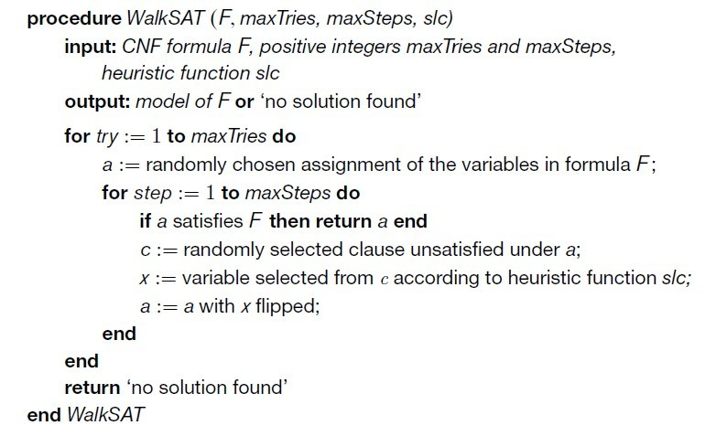

Slide 76
Adapt CDRW to subset problem
In local search for vertex cover problem, each step exchange two vertices, one is removed from the candidate solution, while another is added to the candidate solution.
Using conflict-directed random walk style, the adding vertex is always selected from an uncovered edge.

Slide 77
Tabu mechanism
Associate tabu attributes with solution components such as variables or vertices.
The solution component that change value recently are labeled ‘tabu’.
Forbids reversing the recent changes, by forbidding changing the value of the solution components labeled ‘tabu’.

Slide 78
Tabu for SAT
An FIFO queue: tabuList[]
Each step
a variable x not in tabuList is chosen to flip the value
Add x to tabuList
If (tabulist.size > tt) remove the first element of tabuList
Think: how to check whether a variable is tabu more efficiently?

Slide 79
Note: Cycles of length at most m can be prevented by
tabu mechanism with tabu tenure tt=m.
Trade-off of choosing tt:
tt too low -> fail to prevent cycling
tt too high -> an excessive restriction of neighborhoods
Advanced TS methods:
Tabu with Aspiration
a variable can be chosen if its score is very large, regardless of whether it is forbidden by Tabu strategy;
Robust Tabu Search [Taillard, 1991]:
repeatedly choose tt from given interval;
Reactive Tabu Search [Battiti and Tecchiolli, 1994]:
dynamically adjust tt during search;

Slide 80
Adaptive Parameter
Typically, there are parameters control the diversification of local search, e.g., tabu tenure, random walk parameter.
To make the algorithms with parameters robust, we need adaptive parameter.

Slide 81
Reactive Tabu Search for MaxClique [Battiti and Tecchiolli, 1994]:
Record all found cliques by hash table.
If a clique is revisited during a short period, increase tabu tenure → enhance diversification
If no clique is revisited during a long period, decrease tabu tenure → enhance intensification

Slide 82
Adaptive Noise for SAT (Hoos 02)
The probability of performing a random step is controlled by a noise parameter wp (walking probability), which is adjusted during the search.
Parameter wp is initialized as 0;
If no improvement is observed during a long period, increase wp → enhance diversification: wp := wp + (1 − wp) · ϕ, where ϕ = 0.2;
If an improvement is observed, decrease wp →enhance intensification: wp := wp − wp · ϕ/2

Slide 83
Constraint Weighting
Associate a number as the weight of each constraint, measuring the cost of violating this constraint.
The evaluation function is changed to the weighted version.
Constraint weighting in Iterative Improvement
When a constraint is violated, increase its weight by 1 .
The constraints with larger weight should be preferred to be satisfied.
Constraint weighting in Iterated Local Search
At local optima, increase weights of all violated constraints by 1
Making a local optimum no longer a local optimum during a period of time.

Slide 84
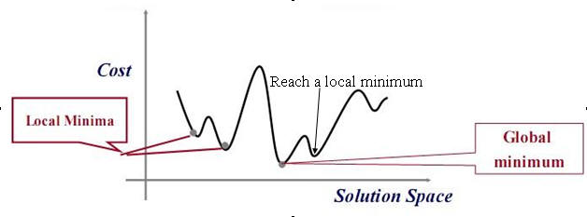

Slide 85
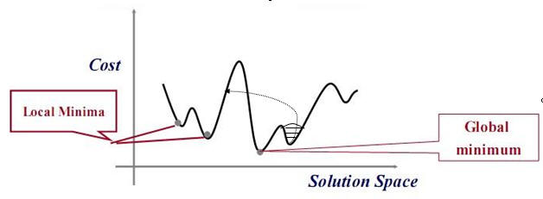

Slide 86
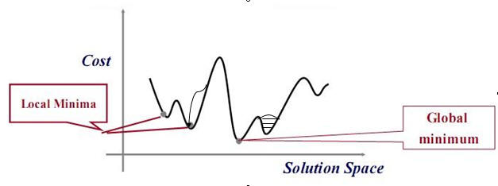

Slide 87
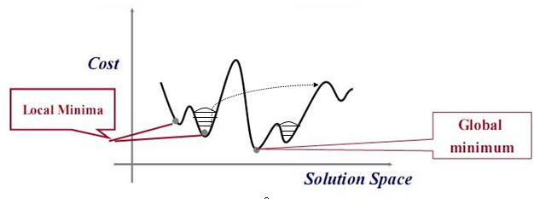

Slide 88
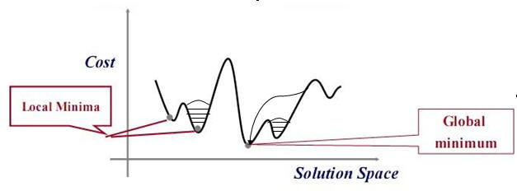

Slide 89
Clause Weighting for SAT
Date back to the Breakout method (1993): increases the weight of each unsatisfied clause by one when reaching local optima.
The Breakout method allows unrestricted weight growth during.
Modern clause weighting usually have a “smoothing” mechanism to decrease clause weights.

Slide 90
Clause Weighting for SAT
discrete Lagrangian method (DLM): DLM follows Breakout’s weight increment scheme, but additionally decrements clause weights by a constant amount after a fixed number of increases;
pure additive weighting scheme (PAWS): PAWS updates clause weights in local optima as follows. First, the clause weights of all unsatisfied clauses are increased by one; then, all clause weights are decreased by one after a fixed number of increases.

Slide 91
Component Weighting
Associate a number as the weight of each solution component, measuring the frequency of a solution component being selected.
Vertex Weighting for MaxClique (Pullan 06)
A GRASP framework: construction + local search
At the end of each local search phase, increase the penalty values of all vertices in the current clique, by one.
In the constructive phase, when selecting a vertex to add into the candidate solution, prefer vertices with lower penalty.

Slide 92
Scoring Functions
A basic Scoring Function
Previously, we introduced a scoring function for SAT, which is named ‘score’.
Under assignment S, score(x) = cost(S)-cost(S‘), where S’ differs from S only in the value of x, cost(S) is the number of unsatisfied clauses under S.
Other Scoring functions
age(x) = the number of steps since x has changed value
frequency(x) = a count on how many times x changes its value
wscore(x) = the weighted version of score, using clause weighting techniques
Score(x)+age(x)/T, where T is a parameter
…

Slide 93
Scoring Functions
A Scoring Function can be
a property of the variable, such as score, age, frequency …
any mathematical expression with one or more properties.
More Scoring functions
A^{score(x)}
score(x)^{B}
score(x)+age(x)/T
…
Dynamic Scoring functions
Change the parameters or the expression of the scoring function during the search

Slide 94
Local Search for SAT

Slide 95
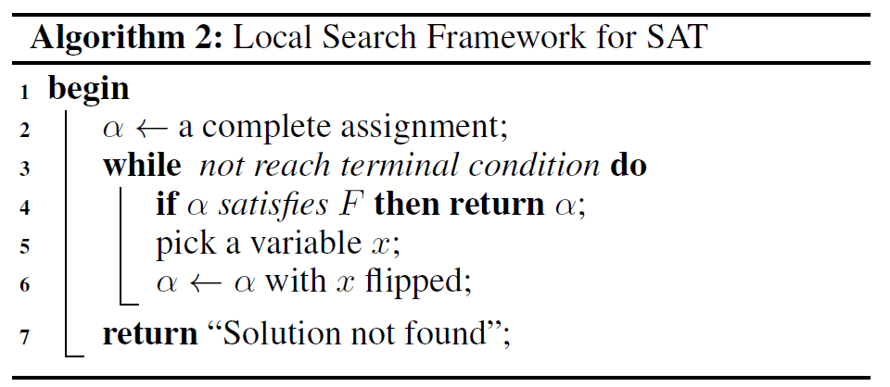
Scoring
functions
Search strategies

Slide 96
Properties of Variables
make(x): the number of currently unsatisfied clauses that would become satisfied by flipping x.
break(x): the number of currently satisfied clauses that would become unsatisfied by flipping x.
score(x): cost(F, s) - cost(F,s’), i.e., the number of currently unsatisfied clauses minus the number of unsatisfied clauses if x were to be flipped.
It is easy to see that score(x) = make(x)-break(x).
age(x): the number of steps since the last time x was flipped.

Slide 97
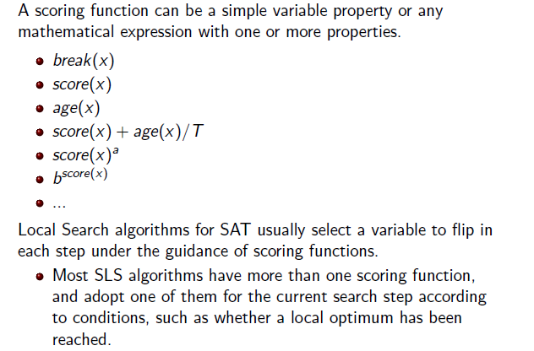
Scoring Functions of Variables

Slide 98
Different types of local search
Local search algorithms for SAT mainly fall into two types:
focused local search: always picks the flip variable from an unsatisfied clause.
two-mode local search: switches between intensification mode(usually using global search) and diversification mode (usually using focused local search).
There is also a significant line of research concerns about weighting techniques.

Slide 99
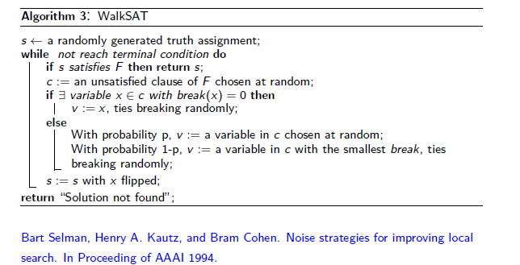
Focused local search
WalkSAT

Slide 100
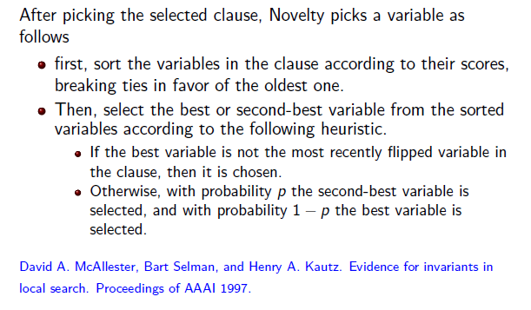
Focused local search
Novelty

Slide 101
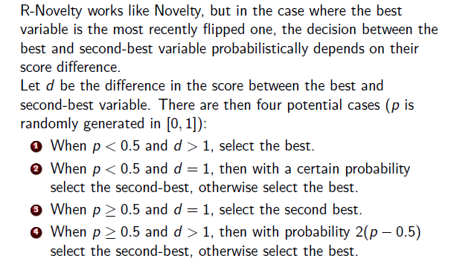
Focused local search
R-Novelty

Slide 102
Focused local search
Novelty+
With with a fixed probability wp , choose a random variable from the selected clause;
in the remaining cases, the steps are similar to Novelty.
Makes it PAC (probabilistic approximately complete)

Slide 103
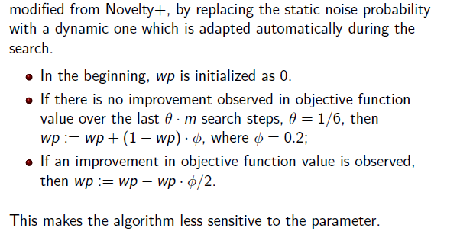
Focused local search
AdaptiveNovelty+

Slide 104
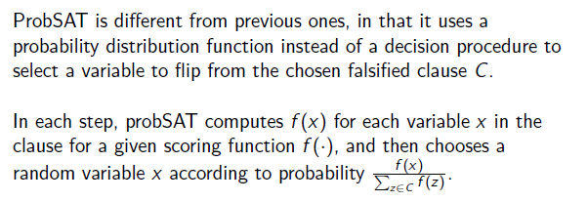
Focused local search
ProbSAT

Slide 105
Two mode local search
Any two-mode local search algorithm can be characterized by specifying the following three components.
intensification mode;
diversification mode;
switching rule.

Slide 106
GWSAT
intensification mode: select a variable with the greatest score;
diversification mode: select a random variable in a random falsified clause;
switching rule: work in the intensification mode with a fixed probability p, and in the diversification mode otherwise.

Slide 107
G2WSAT
Promising decreasing variables: a decreasing variable is said to be promising if and only if it becomes decreasing due to the flip of other variables rather than itself.
intensification mode: select the best promising decreasing variable (w.r.t. score);
diversification mode: select a variable in a random falsified clause according to the Novelty++ heuristic.
switching rule: work in intensification mode if promising decreasing variables exist, and in diversification mode otherwise.

Slide 108
g2Novelty (3-mode local search)
With a probability wp, selects a random variable in a random falsified clause;
intensification mode: select the best promising decreasing variable (w.r.t. score);
diversification mode: select a variable in a random falsified clause according to the AdaptNovelty+ heuristic.
switching rule: work in intensification mode if promising decreasing variables exist, and in diversification mode otherwise.

Slide 109
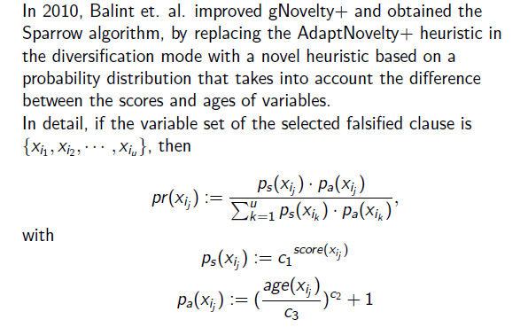
Sparrow

Slide 110
Clause Weighting
Clause weighting techniques serve as a form of diversification in local search.
Local search algorithms using such weighting techniques are also known as dynamic local search (DLS).
Clause weighting techniques associate an integer number to each clause as its weight, which are updated during the search.
DLS algorithms choose a variable to flip on the basis of minimizing the total weight of falsified clauses.
The basic concept of clause weighting is to increase the weight of falsified clauses and thus help to diversify the search.

Slide 111
The breakout method
Clause weighting techniques for SAT date back to the Breakout method, which simply increases the weight of each falsified clause by one when reaching local optima and allows unrestricted weight growth during the search.

Slide 112
The discrete Lagrangian method
In its simplest form, DLM follows Breakout's weight increment scheme, but additionally decrements clause weights by a constant amount after a fixed number of increases.

Slide 113
Pure Additive Weighting Scheme (PAWS)
When reaching local optimum:
First, the clause weights of all falsified clauses are increased by one;
then, all clause weights are decreased by one after a fixed number of increases.

Slide 114
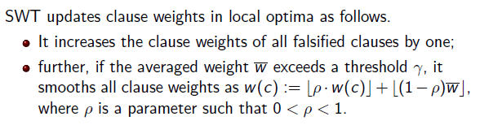
Smooth Weighting based on Threshold (SWT)
As adjusting all clause weights are costly, one way is to perform smoothing only when the weights are too large.

Slide 115
Thinking about local search for vertex cover
Focused local search
Two mode local search
Edge weighting

Slide 116
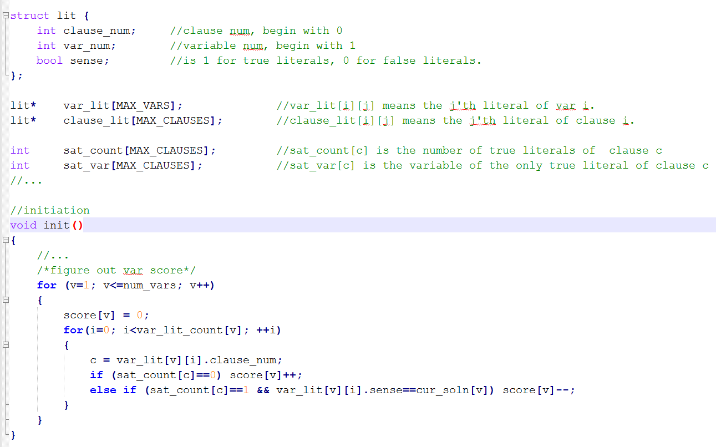
Caching based Score Computation

Slide 117
